Slide 1
Homework #2
2018 Fall, GCT522, Computer Graphics Theory and Application
Hanui Lee
2018.09.12

Slide 2

Homework #0
Name Animation

Slide 3
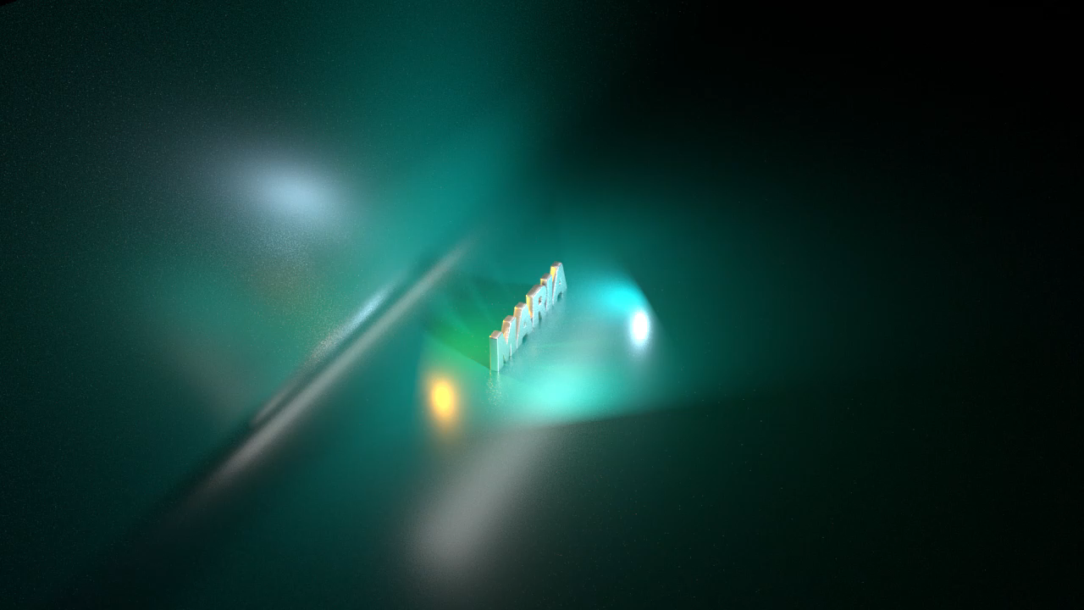

Slide 4


Slide 5


Slide 6
Homework #2
Smart Modeling

Slide 7
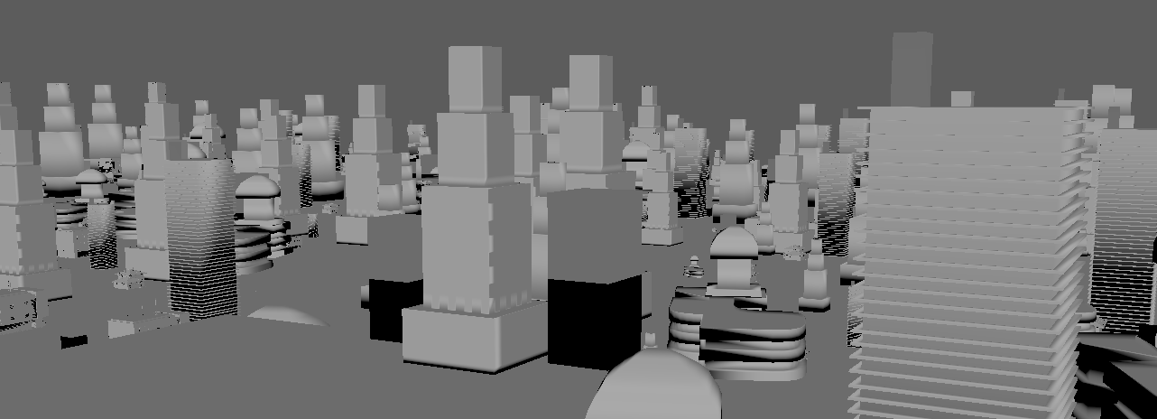
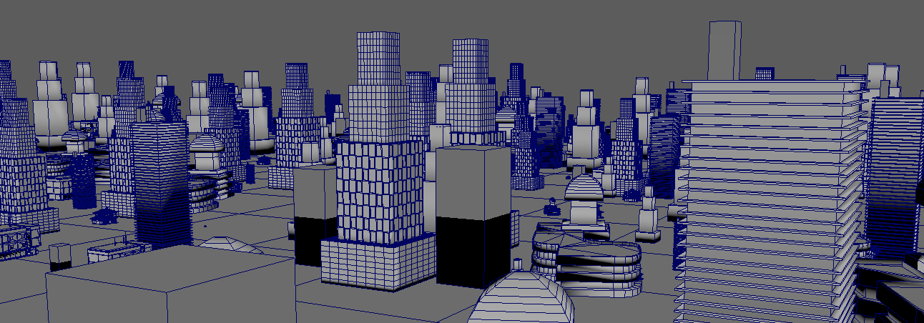
Goal

Slide 8
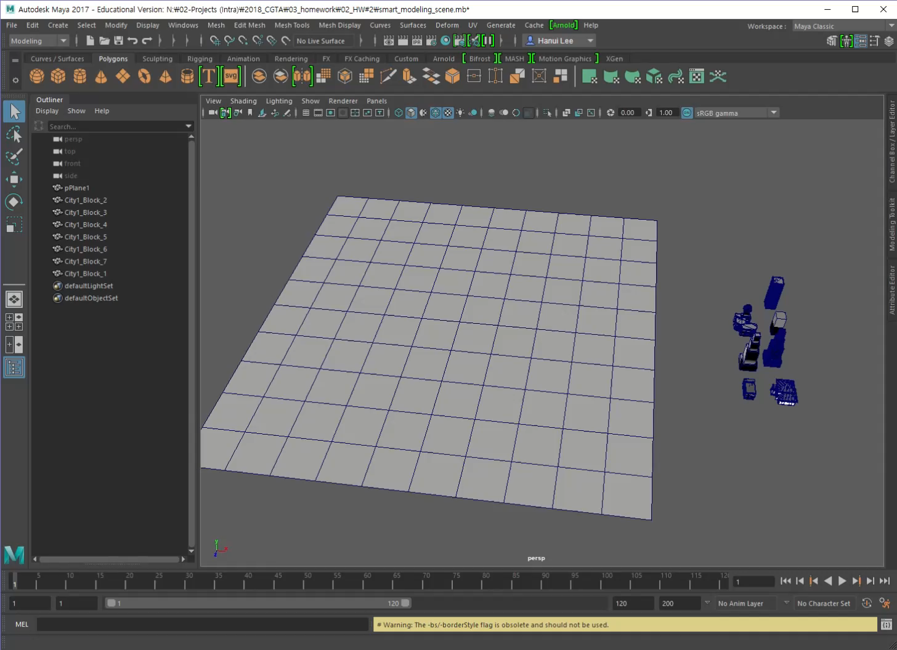
Goal

Slide 9
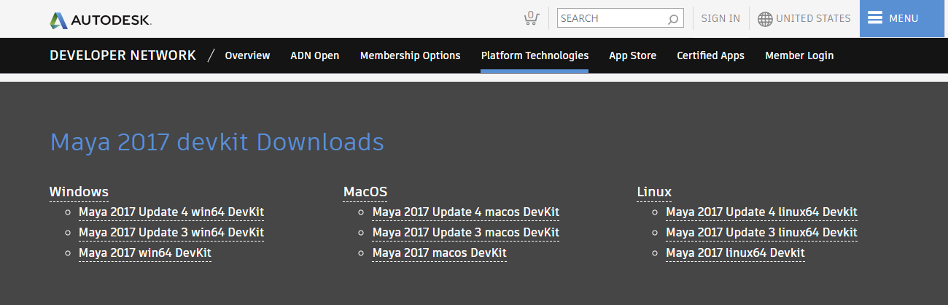
Setting
1. Install the ‘Maya Developer Kit’
Download ‘Maya Developer Kit’ at
https://www.autodesk.com/developer-network/platform-technologies/maya

Slide 10
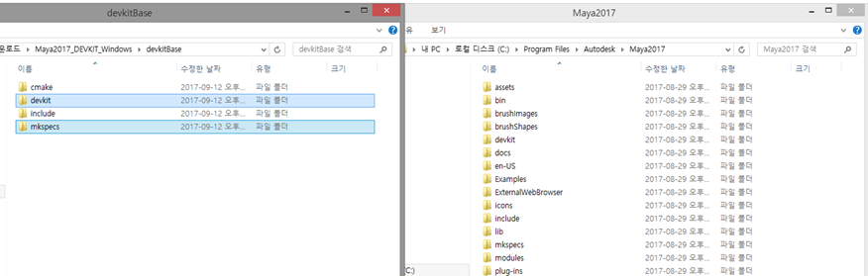
Setting
1. Install the ‘Maya Developer Kit’
2) Unzip the devkitBase folder and copy devkit, mkspecs folders to Maya2017 folder

Slide 11
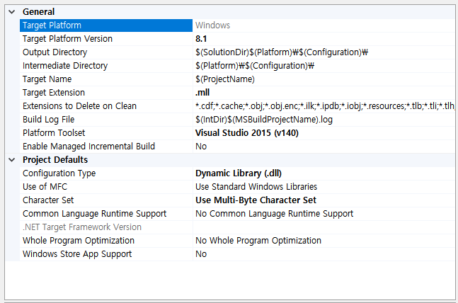
Setting
Visual Studio
2. Make a new empty project
3. Change the project’s properties
Set the active solution platform to x64
Under General:
Set Target Extension to .mll
Set Configuration Type to ‘Dynamic Library(.dll)’
https://beesoverdundee.wordpress.com/2015/04/02/tutorial-making-maya-2015-plugins-with-visual-studio/

Slide 12
Setting
Visual Studio
3. Change the project’s properties
Under C/C++ - General:
Set Additional Include Directories : Path\to\Maya2017\include
Under C/C++ - Preprocessor:
In Preprocessor Definitions
: WIN32; NDEBUG; _DEBUG; _WINDOWS; NT_PLUGIN; REQUIRE_IOSTREAM; _USRDLL;
MAYAPLUGIN1_EXPORTS;
Under C/C++ - Code Generation:
Set Runtime Library to ‘Multi-threaded Debug DLL’
https://beesoverdundee.wordpress.com/2015/04/02/tutorial-making-maya-2015-plugins-with-visual-studio/

Slide 13
Setting
Visual Studio
3. Change the project’s properties
Under Linker - General:
Set Output File to $(OutDir)$(ProjectName).mll
Additional Library Directories: Path\to\Maya2017\lib
Under Linker - Input:
Additional Dependencies: Foundation.lib; OpenMaya.lib; OpenMayaUI.lib; OpenMayaAnim.lib; OpenMayaFX.lib; OpenMayaRender.lib; Image.lib; opengl32.lib;
Under Linker – Command Line:
Additional Options: /export:initializePlugin /export:uninitializePlugin
https://beesoverdundee.wordpress.com/2015/04/02/tutorial-making-maya-2015-plugins-with-visual-studio/

Slide 14
Setting
Visual Studio
4. Do your homework(Maya programming)
First, practice with examples in Complete Maya Programming (Posts1 - 5, Clock example)
1. How to make custom Maya Command by using C++ Maya API
2. How to use arguments of command
3. How to access and control Maya object by using C++ Maya API
5. Build the solution

Slide 15
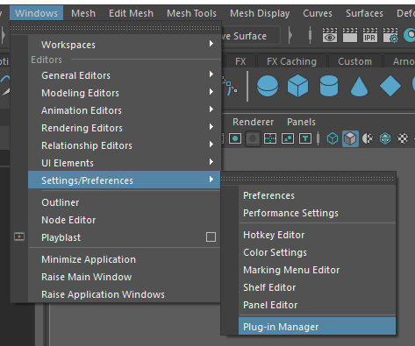
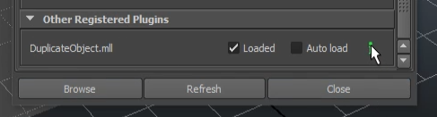
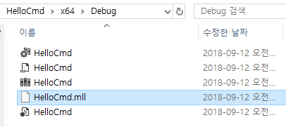
Setting
Maya
6. Load your own plugin
Plug-in Manager > Browse > ‘your own *.mll file’
1
2
You can find the path through the output window (Visual studio), after building the solution.

Slide 16

Homework #2
Smart Modeling
Get familiar with MAYA API
Make custom Python UI and MEL Command
5 Points
4 requirements
Due date
1th, October, 14:30

Slide 17
Requirements
Create python graphical user interface (1.0 points)
Change height scale of the duplicated objects randomly
MEL command with more than 2 arguments (1.0 point)
Refer to Ch. 4.4.3 of Complete Maya Programming(ex. posts2 – number 10)
Arrange objects on the plane (2.0 points)
Duplicate given objects and arrange them randomly on a given plane
Undo/Redo(1.0 point)
Create your own class to provide a perfect ‘Undo’ and ‘Redo’

Slide 18
Workflow
1. Create a class using the MPxCommand framework
2. Get selected object from UI, using MArgDatabase, Mglobal::getSelectionListByName
3. Register each object into related Class
- Target object(plane) should be registered, using MDagPathArray
- Source object should be registered, MObjectArray, MFnTransform
4. Iterate over mesh vertices using MItMeshVertex
- Get positions from vertices
5. Duplicate objects
- Objects are randomly generated(duplicated) on the plane (at the vertex position of target object)
- Objects’height(scale) are randomly changed.
- Connect them to its shading group
- Save generated objects for Undo/Redo

Slide 19
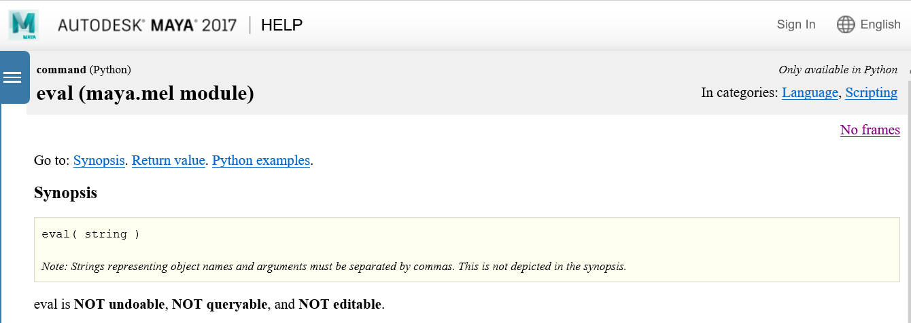
Tips
To run Maya MEL command within Python
eval function :
http://help.autodesk.com/view/MAYAUL/2017/ENU/?url=http://help.autodesk.com/cloudhelp/2017/ENU/Maya-Tech-Docs/CommandsPython/eval.html

Slide 20

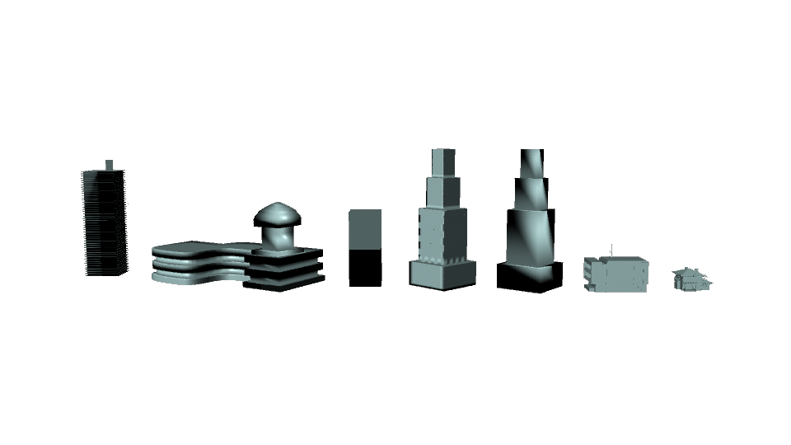
Tips
Register objects
MDagPath dagMesh;
MFnMesh fnMesh;
fnMesh.setObject( dagMesh );
MObject dagModel;
MFnTransform fnTransform;
fnTransform.setObject( dagModel );

Slide 21
Tips
Iterate over the mesh vertices
MItMeshVertex iterVtx( dagMesh );
for( ; !iterVtx.isDone() ; iterVtx.next() )
{
iterVtx.Something( … , … );
}
For example…
1. position (vertex position on current iterator)
2. getNormal (vertex normal on current iterator)

Slide 22
Tips
Duplicate an object
//During the iteration
MObject instance = fnTransform.duplicate();
// Register the duplicated instance and set its transformation
MFnTransform fnInstance( instance );
fnInstance.setSomething( … , … );
For example…
1. setTranslation (move a current instance to a vertex position )
2. setRotation (rotate a current instance with a caculated angle)
3. boundingBox (get the bounding box information of the object)

Slide 23
Tips
Initial Shading Group
Refer to a Ground-Shadow plug-in in your textbook
MSelectionList sList;
sList.clear( );
MGlobal::getSelectionListByName( "initialShadingGroup", sList );
sList.getDependNode( 0, shadingGroupObj );
MFnSet shadingGroupFn;
shadingGroupFn.setObject( shadingGroupObj );
// Connect a duplicated instance with initial shading group during the iteration
shadingGroupFn.addMember( instance );

Slide 24
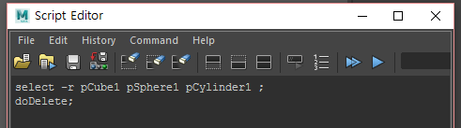
Tips
Undo/Redo
Hint 1.
MObjectArray instanceArray;
Hint 2.
MGlobal::executeCommand(“Something”);
Hint 3.
For “Something”, make polygons in maya(ex. cube, sphere, cylinder,..) and delete them.
Then, watch your script editor. You can see some MEL commands. ☺

Slide 25
References
Maya 2017 API reference
($MAYA_PATH)\devkit\plug-ins\(example)
(ex. HelloWorldCmd…)
Complete Maya Programming Example
KLMS

Slide 26
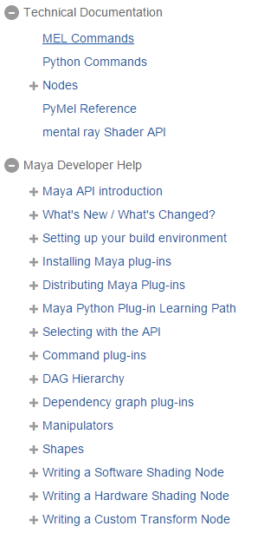
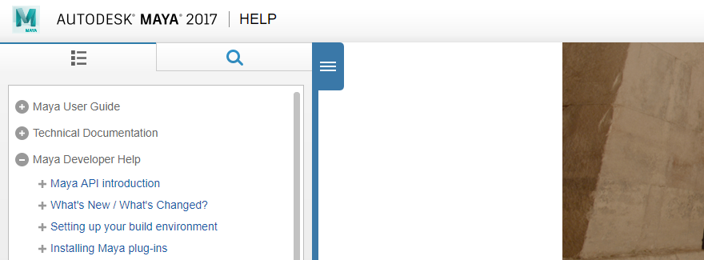
References(***)
AUTODESK MAYA Help
http://help.autodesk.com/view/MAYAUL/2017/ENU/

Slide 27
Submission files
Source code :
.sln / .cpp / . h / .vcproj (Please do not send me *.sdf)
Complied binary file :
.mll file not dll
Readme.txt file :
Target Machine & software(ex. Maya 2017, Visual Studio 2015, x64)
How to use your Command(Please explain in detail)
Screen Capture file:
Output window for checking your name
Result scene

Slide 28
Workflow
1. Create a class using the MPxCommand framework
2. Get selected object from UI, using MArgDatabase, Mglobal::getSelectionListByName
3. Register each object into related Class
- Target object(plane) should be registered, using MDagPathArray
- Source object should be registered, MObjectArray, MFnTransform
4. Iterate over mesh vertices using MItMeshVertex
- Get positions from vertices
5. Duplicate objects
- Objects are randomly generated(duplicated) on the plane (at the vertex position of target object)
- Objects’height(scale) are randomly changed.
- Connect them to its shading group
- Save generated objects for Undo/Redo
Upload your files to KLMS
until 1th, October, 14:30

Slide 29
Q/A
Hanui Lee
honeylee@kaist.ac.kr
#2344, N5 Building / Visual Media Lab. in GSCT

